Slide 1

Kwizera Olivier
Web Tech Summer 2025 Final Exams

Slide 2
Project Description
Olivier is developing a comprehensive digital marketplace and advisory platform called AgriShop Rwanda. The platform enables smallholder farmers and agricultural buyers to connect directly through an intuitive online marketplace designed to promote fair trade, price transparency, and agricultural empowerment. Users can buy and sell fresh produce, access real-time market prices, and receive location-based weather and farming advisory services,all through an easy-to-use web interface.

Slide 3
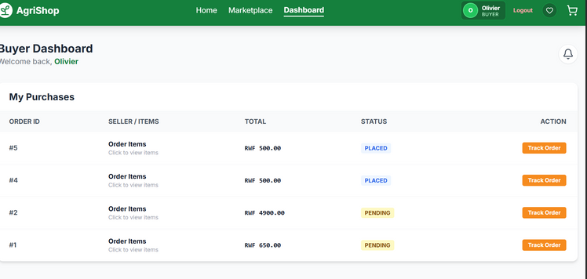
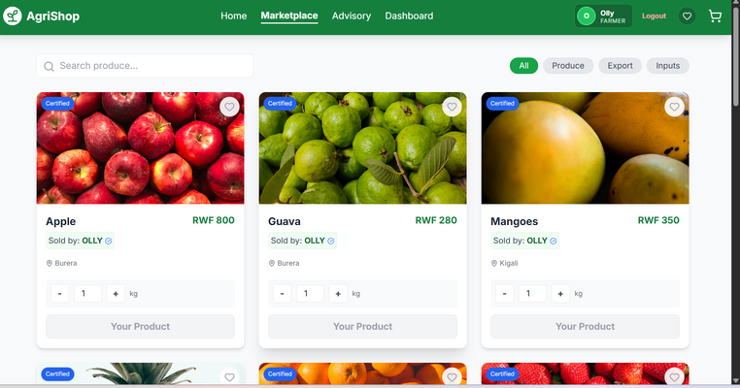
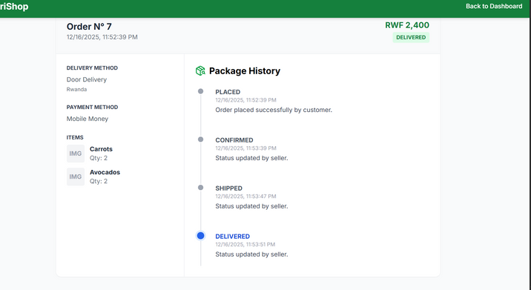
Project Title
Jean (Smallholder Farmer)
Age: 42
Owns a small farm producing vegetables and fruits. He wants fair prices, reliable buyers, and simple digital tools to sell his produce without middlemen
PROBLEM:
Farmers are better off because they can sell directly to buyers, manage inventory digitally, access market insights, and receive weather-based guidance
armers struggle to access fair markets and real-time price information
Buyers are better off because they gain reliable access to fresh produce, transparent pricing, verified sellers, and efficient ordering
Buyers face difficulty sourcing fresh produce directly from trusted farmers
Aline (Buyer – Restaurant Owner)
Age: 30
Runs a local restaurant and needs consistent access to fresh, organic produce. She values transparent pricing, quality assurance, and quick ordering
Middlemen reduce farmer profits and increase buyer costs
Platform Administration benefits from centralized oversight, data-driven insights, and scalable digital infrastructure supporting agricultural trade
Limited access to advisory services and localized weather insights affects productivity

Slide 4
User / Customer
Business: AgriShop Rwanda – Digital Agricultural Marketplace
Services: Produce trading, advisory services, market insights
User Roles:
Farmers: List products, manage inventory, access analytics
Buyers: Browse, search, purchase, review products
Admin: Manage users, content, and system operations

Slide 5
Functions
Easy buying and selling for everyone: farmers can list their produce, and buyers can easily browse and purchase fresh agricultural products online.
Designed for busy users: buyers and farmers can trade without going to physical markets or spending long hours negotiating with middlemen.
Product marketplace and search: users can view products by category, price, and location to quickly find what they need.
Advisory and weather information: farmers can access farming tips and weather updates to help them make better farming decisions

Slide 6
3 tier architecture
PRESENTATION TIER
APPLICATION TIER
DATA TIER
HTML5 / CSS3
Tailwind CSS
JavaScript (ES6)
Responsive Web Design
User-friendly marketplace interface
Farmer & buyer dashboards
Accessibility-focused UI (USSD simulation)
PHP (Server-side scripting)
Authentication & Authorization
Role-based access (Farmer, Buyer, Admin)
Marketplace business logic
Product & oUser-friendly marketplace interface
Farmer & buyer dashboards
Users Table (Farmers, Buyers, Admins)
Products Table
Orders Table
Reviews & Ratings Table
Farmer Profiles Table
Advisory & Location Data Tables

